Slide 1
Building Geography Skills
Day 2

Slide 2
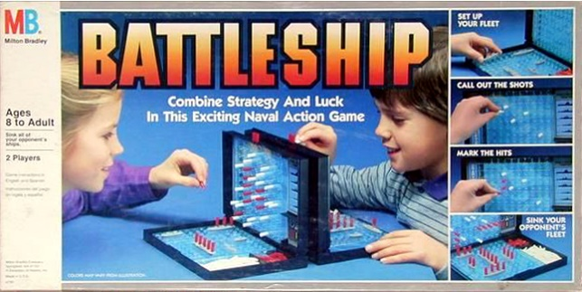
Have You…
Have you ever played the game Battleship? If you have, write a description of how you play. If you haven’t, write a question you might have about the game.
Share with a partner.

Slide 3
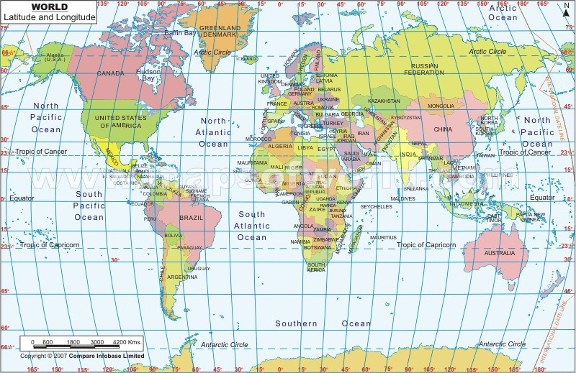
Latitude and longitude is a system mapmakers created to note the exact location of places on the earth.

Slide 4
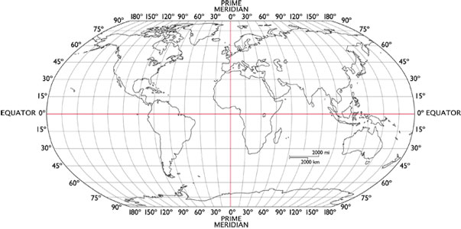
Latitude and longitude are two sets of imaginary circles crossing Earth. These circles are numbered in units called degrees.

Slide 5
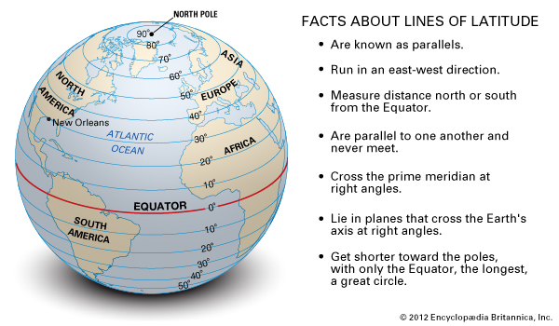
Lines of latitude are the set of circles that go east and west but measure north and south. These circles are parallel.

Slide 6
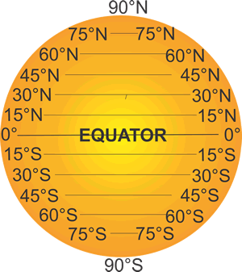
The equator is at 0 degrees latitude. The North Pole is at 90 N latitude and the South Pole is at 90 S latitude.

Slide 7
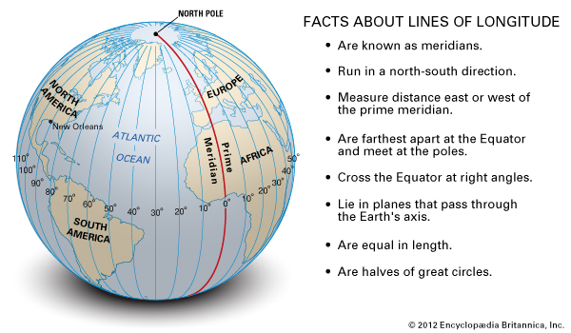
Lines of longitude are the set of circles that go north and south but measure east and west.

Slide 8
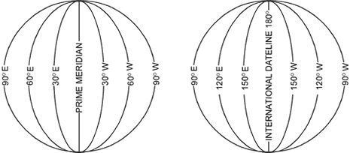
The prime meridian is at zero degrees longitude. These circles are not parallel and go east and west for 180 degrees.

Slide 9
Please Do Now!
Please read pgs. H6-H11 in your social studies text. While you read, write three interesting facts you learned.

